Slide 1

World Happiness
2021

Slide 2
Introduction
The data set that we found showed world happiness ratings for counties in the year 2021.
The data included: (After ELT)
Ladder Scores: The rankings of national happiness are based on a Cantril ladder survey. Nationally representative samples of respondents are asked to think of a ladder, with the best possible life for them being a 10, and the worst possible life being a 0. They are then asked to rate their own current lives on that 0 to 10 scale.
Generosity: Generosity is the residual of regressing national average of response to the GWP question “Have you donated money to a charity in the past month?” on GDP per capita. Negative affect is defined as the average of three negative affect measures in GWP.
Healthy life expectancy: Shows the age in which a healthy individual is expected to live.

Slide 3
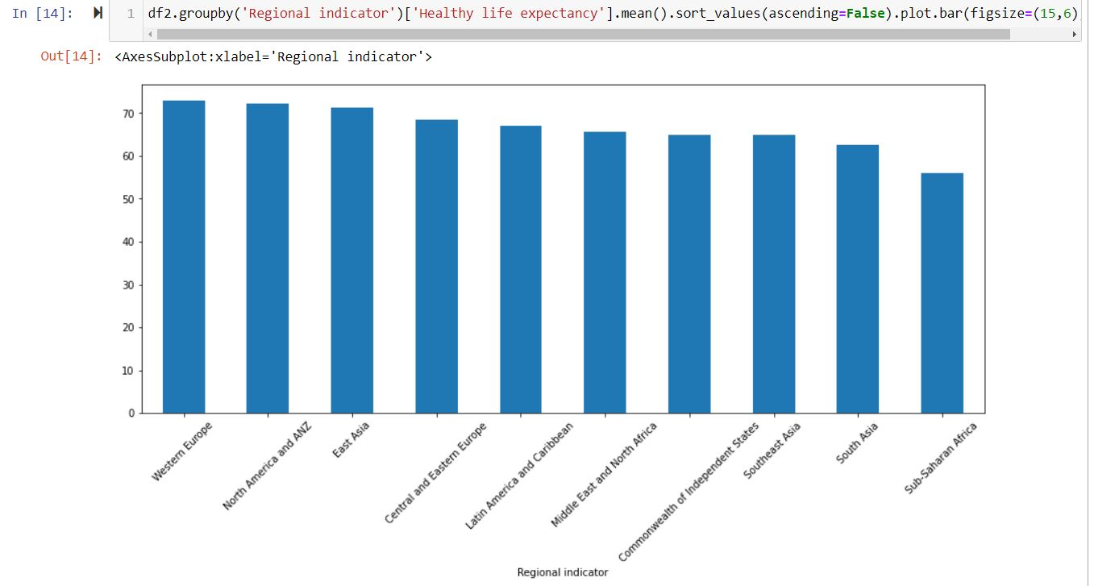
Who is the Happiest
Happiest - Western Europe; North America & ANZ
Least Happy – Sub-Saharan Africa; South Asia.

Slide 4
Does Healthy life expectancy or Generosity Correlate
“We live far happier lives when we are generous in as many ways as possible.” ― Cathy Burnham Martin

Slide 5

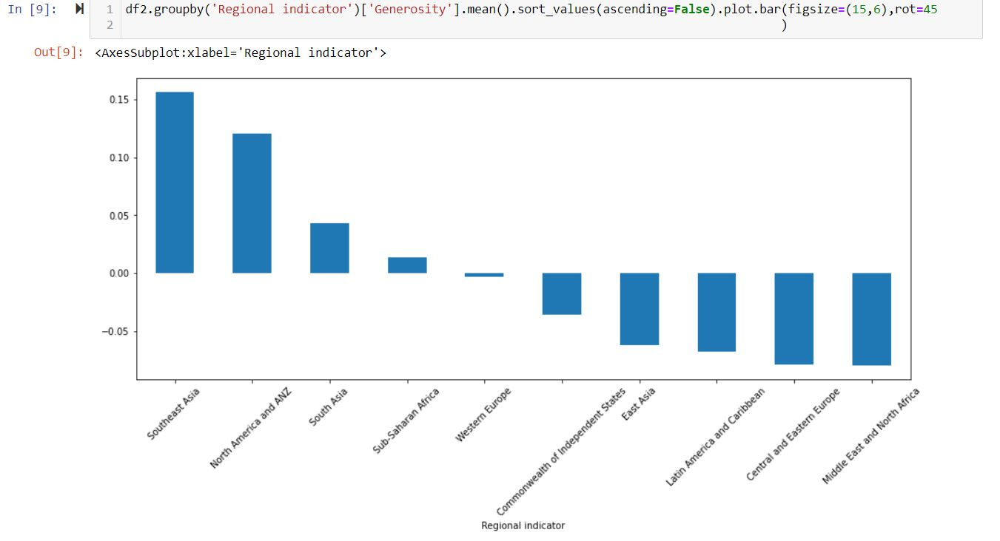
Generosity
The most generous nations seem to be among the least happy.

Slide 6

Questions?

